Slide 1
AppSource, Marketplace and CSP

Slide 2
AppSource

Slide 3

Microsoft AppSource
One destination for business users to discover, trial, and acquire line-of-business SaaS apps
Simplifies the discovery, trial, and acquisition of line-of-business apps
An ecosystem to help business users get started using apps faster
Helps business users do more with their existing Microsoft Apps

Slide 4
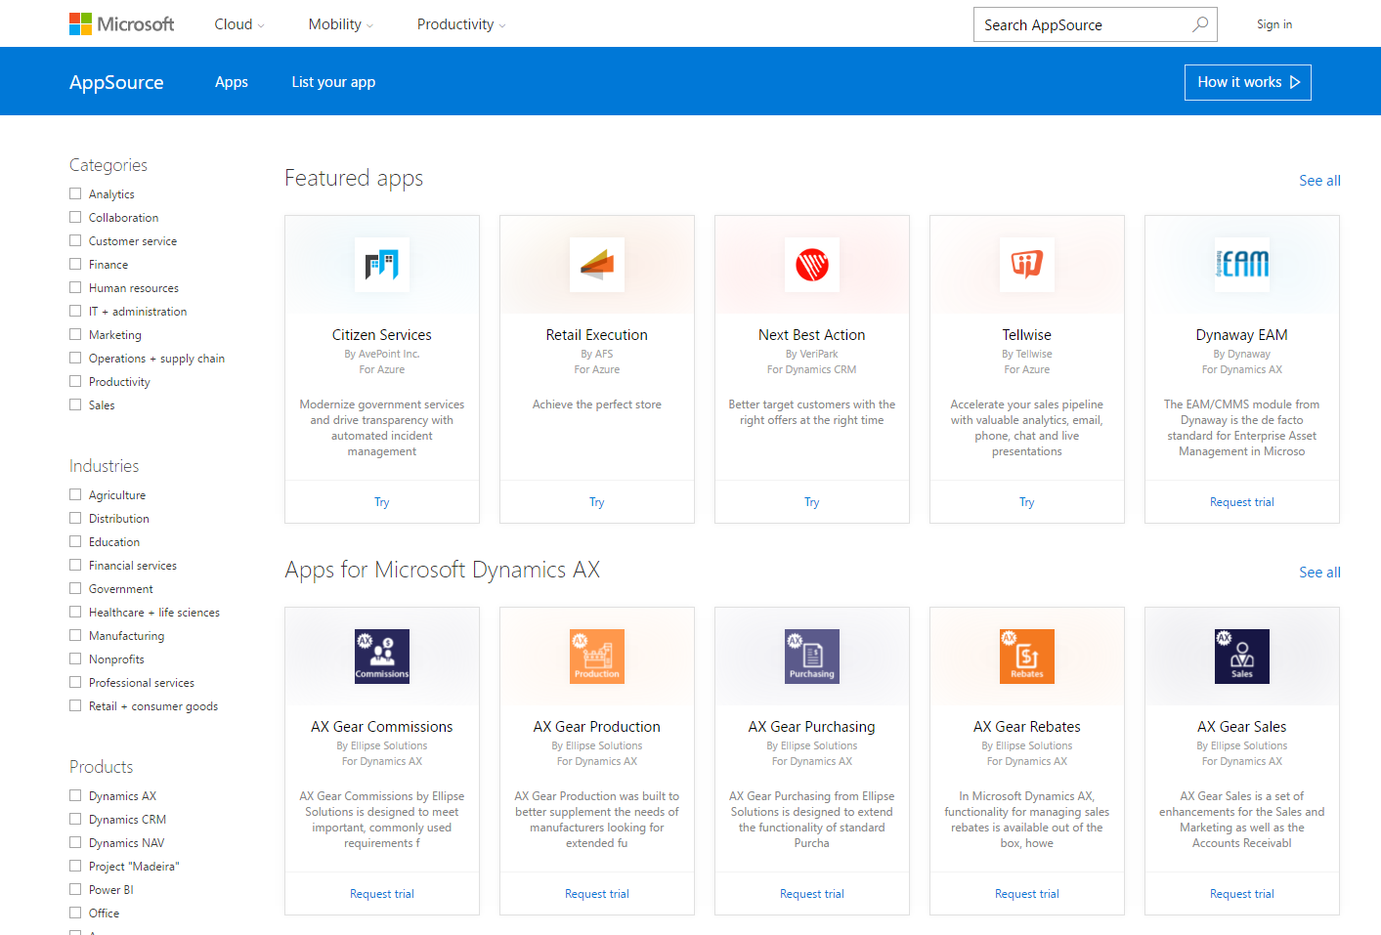
Partner opportunity
$57B+
61%
Opportunity for SaaS apps
Your LoB
app here
Independent software vendors
of technology projects funded by LoB
Line of Business users
81%
By 2019
of technology projects influenced by LoB
Global reach

Slide 5
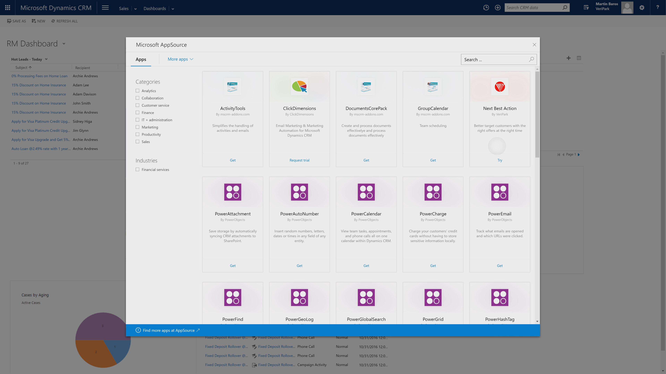
AppSource surfaced in Microsoft products

Slide 6
Marketplace

Slide 7
Agenda
What is Azure Marketplace
Overview of marketplace
Azure certify and Azure ecosystem
Azure Compute Based Solutions
Virtual Machine Images
Solution Templates
Virtual Machine Extensions
Demos
Deploying Solutions from the Portal and Command Line
Troubleshooting

Slide 8
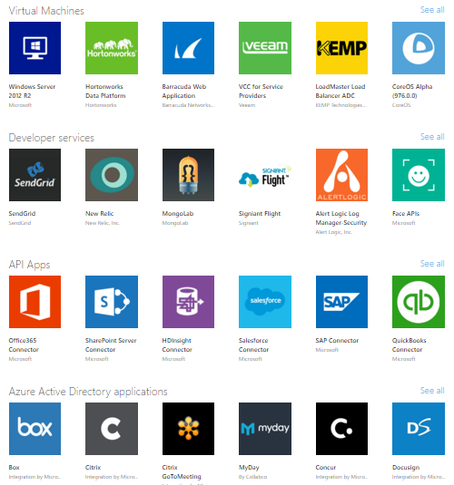
What is Azure Marketplace
Online store for Applications
Certified 3rd party applications
Linux and Windows based solutions
Easy to deploy

Slide 9
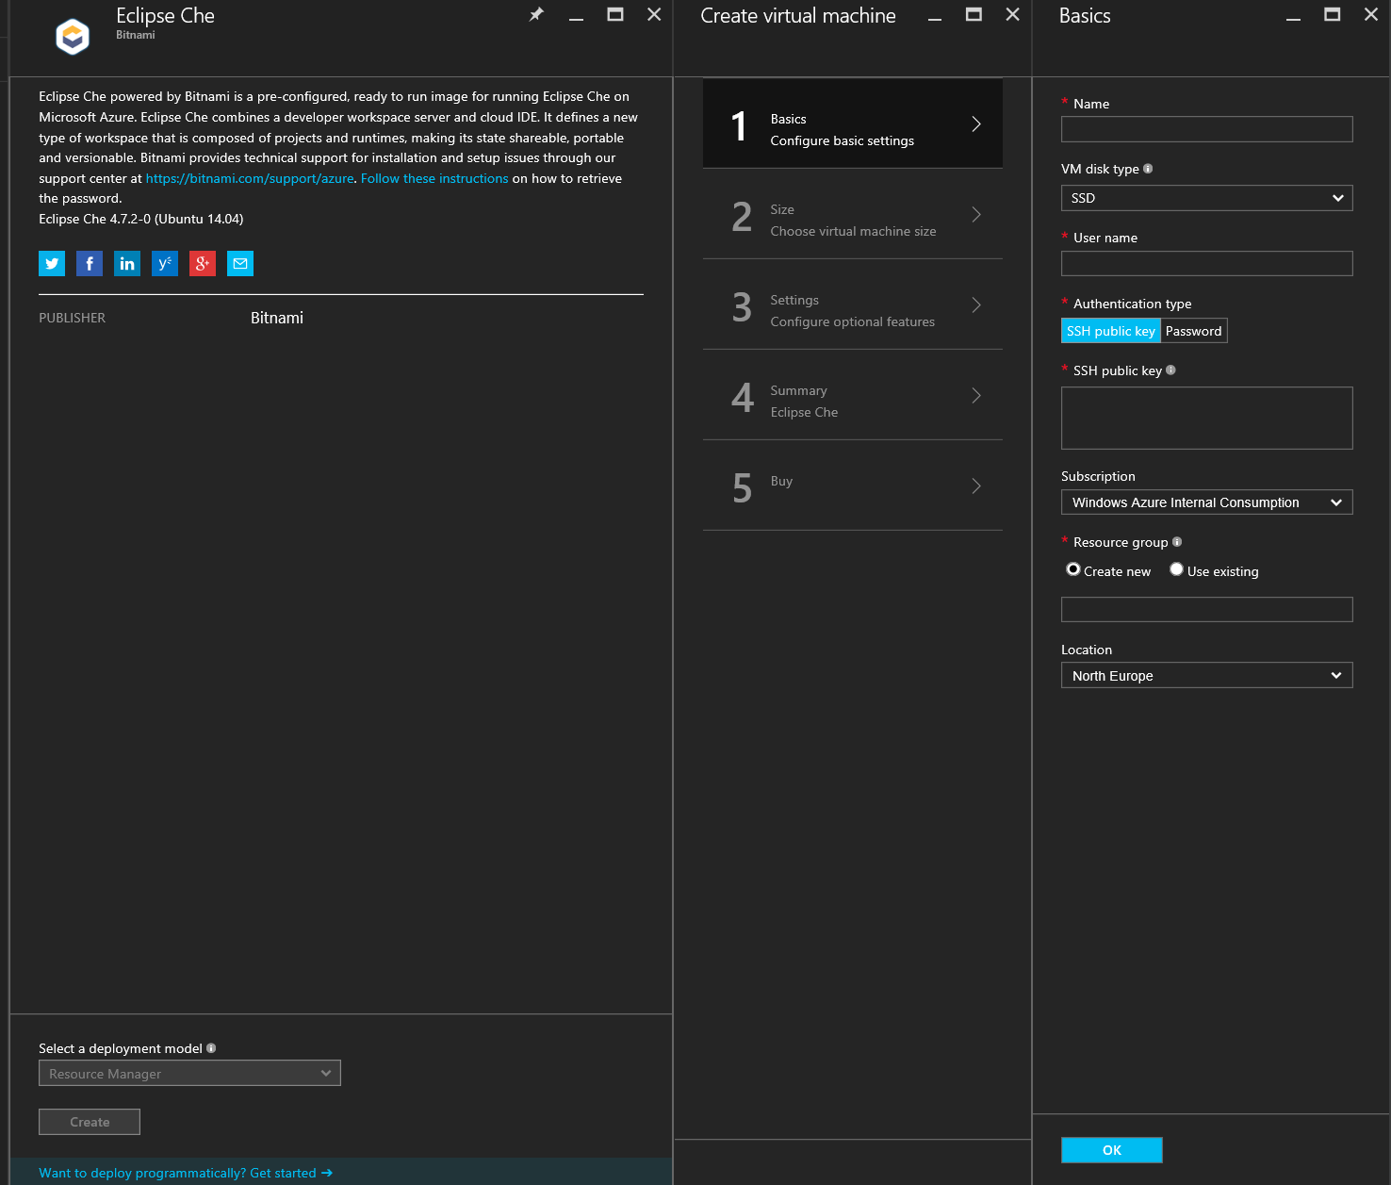
Marketplace Virtual Machine Images

Slide 10
Deploying an Azure Marketplace VM from the Portal and PowerShell

Slide 11
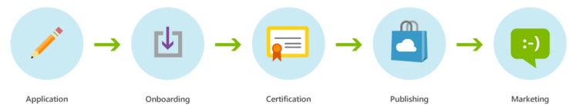
Publisher Flow
https://azure.microsoft.com/en-us/documentation/articles/marketplace-publishing-getting-started/

Slide 12
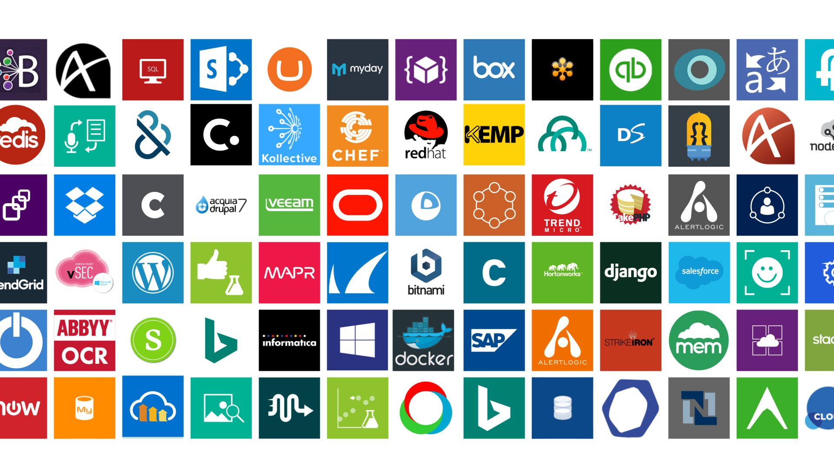
Explore popular software running on Azure!
Visit the Azure Marketplace Arcade!
MS20—located at back left of Microsoft Showcase

Slide 13
CSP

Slide 14
Questions?

